Slide 1
Theory of Automata
Lecture # 07
Dr. Muhammad Fayaz

Slide 2
Deterministic Finite Automata (DFA) and Non-Deterministic Finite Automata (NFA)

Slide 3
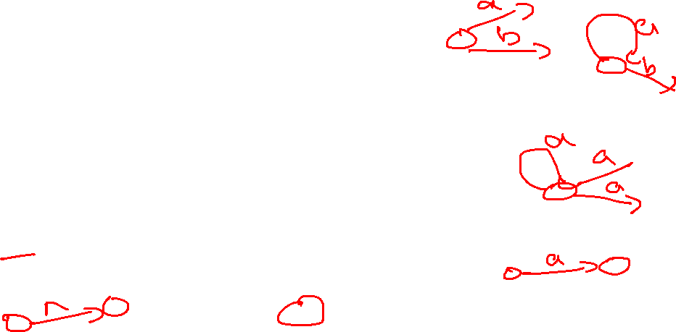
DFA and NFA
DFA:
For every state q in S and every character α in Σ, one and only one transition of the following form occurs:
a , b
a , b
Σ=(a , b)
-
+
NFA:
For every state q in S and every character α in Σ ∪ {e}, one (or both) of the following will happen:
Λ
occurs
Empty transition:
-
+
a
occurs
More than one transitions on same alphabet:
-
+
All these are not allowed in DFA
a
+
a
…
Only one transition:
-
+

Slide 4
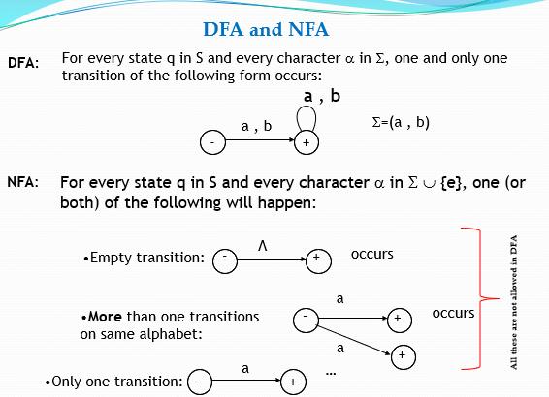
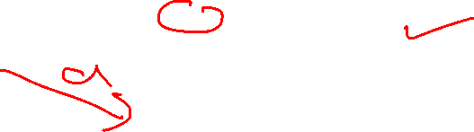
Example-NFA
Regular Expression = b(a + b)* , may be accepted by the following NFA
a,b
––
b
+

Slide 5

Example-NFA
Example:
Regular Expression: Λ + (a + b)*a
a,b
––
a
+
Λ
+

Slide 6
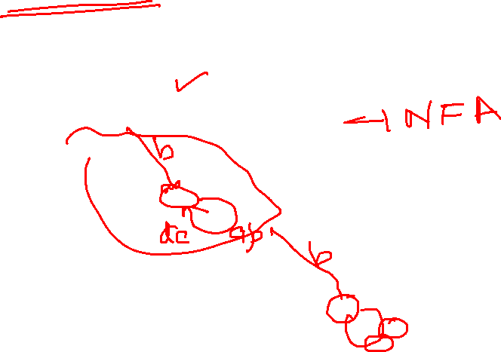
Example:
Regular Expression =
a ((a + b)(a + b))*
NFA
DFA
6
In order to covert the above NFA to DFA a new state namely dead state is introduced.
Dead State

Slide 7
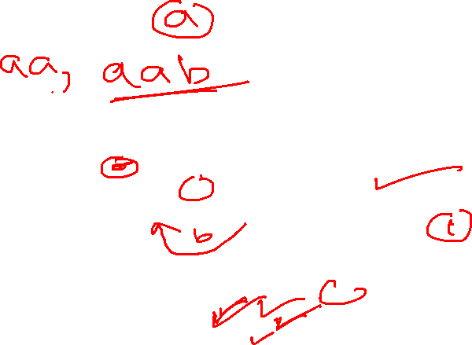
Example:
(a+ b)*aa (a + b)*
NFA
a, b
b
a
a
-
+
DFA
b

Slide 8
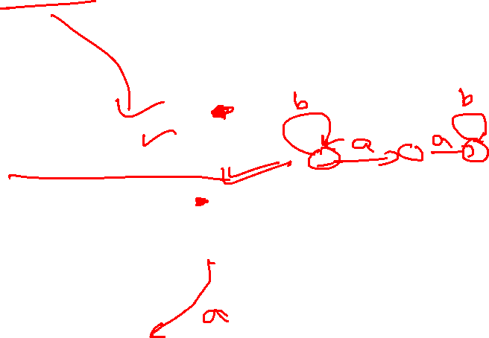
Example:
Regular Expression = b*aa b*
NFA
a, b
b
a
a
-
+
DFA
8
In order to covert the above NFA to DFA a new state namely dead state is introduced.
b
a, b
Dead State

Slide 9
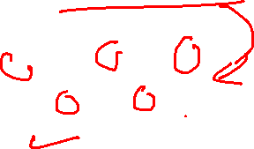
Example:
Regular Expression = b* + b*ab* + b*aa b*
b
b
b
NFA
+
a
a
-
+
+
b
b
b
+
a
a
-
+
+
DFA
9
In order to covert the above NFA to DFA a new state namely dead state is introduced.
a
a, b
Dead State

Slide 10
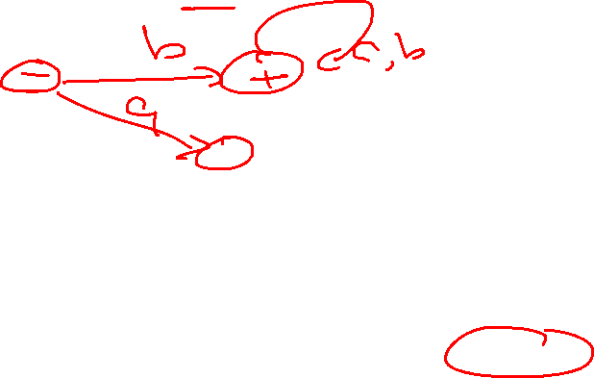
Example:
Regular Expression = b (a + b)*
a,b
––
b
+
a,b
DFA
a
Regular Expression = b(a + b)*
Dead State

Slide 11
Example:
Regular Expression = ((a + b)(a + b))*
a, b
x ±
y
a, b
DFA
11

Slide 12
Example:
Regular Expression = (a + b)((a + b)(a + b))*
a , b
–
+
a, b
DFA

Slide 13
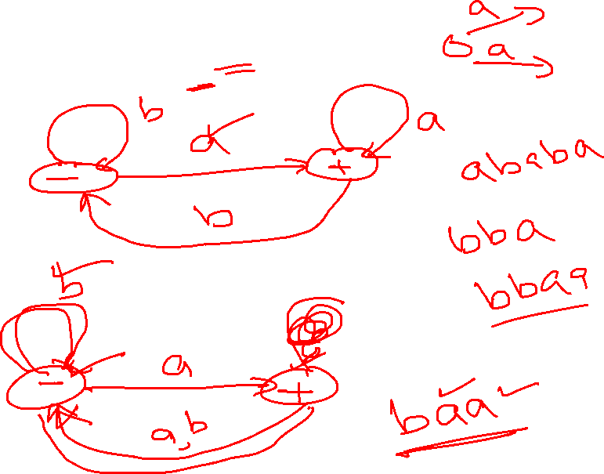
Practice:
Regular Expression = (a + b)*a

Slide 14
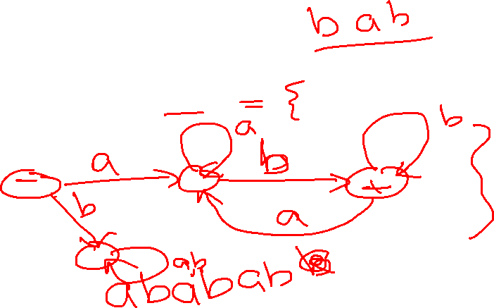
Practice:
Regular Expression = a(a + b)*b

Slide 15
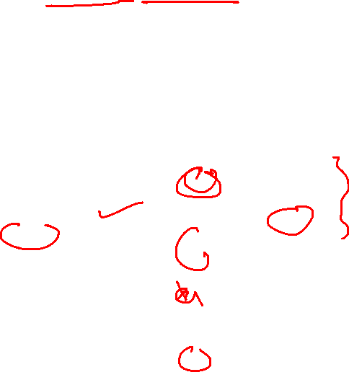
Example:
Regular Expression = a (a + b)* b + b (a + b)* a
a
b
b
2
4+
a
a
1–
b
a
a
b
5+
3
b

Slide 16
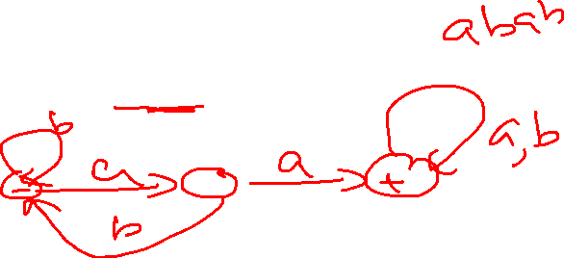
Example:
Regular Expression = (a + b)* aa (a + b)*
b
a,b
a
2
a
1-
3+
DFA
b

Slide 17
Example: Regular Expression =(a + b)* aa (a + b)* + (a + b)*bb (a + b)*
x
a
a
a , b
-
a
b
+
b
b
y
DFA

Slide 18
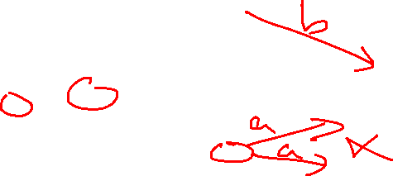
Example:
Regular Expression = (a + b)* bbb ( a + b )*+ (a + b)* aaa ( a + b )*
2
a
4
a
a
a,b
a,b
1–
6+
b
b
NFA
3
b
5

Slide 19
Example:
Regular Expression = (a + b)* bbb ) ( a + b )*+ (a + b)* aaa ( a + b )*
2
a
4
a
a
b
a,b
1––
a
b
6+
b
a
b
DFA
3
b
5

Slide 20
Example
Consider the EVEN-EVEN language, defined over Σ={a, b}.
EVEN-EVEN language can be expressed by the regular expression
Regular Expression=(aa+bb+(ab+ba)(aa+bb)*(ab+ba))*

Slide 21
Example:
Regular Expression=(aa+bb +(ab+ba)(aa+bb)*(ab+ba))*
b
1±
3
b
a
a
a
a
b
2
4
b

Slide 22
Recap
Non-Deterministic Finite Automata (NFA)
Deterministic Finite Automata (DFA)
Difference B/W DFA and NFA
Solved Examples

Slide 23
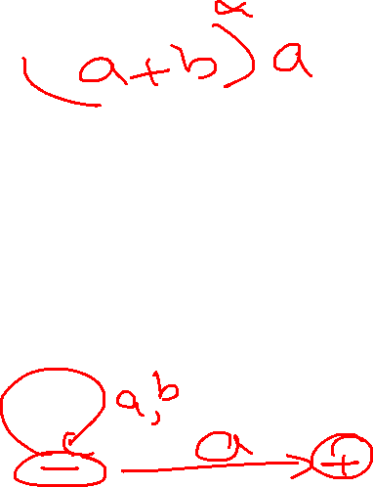
Conversion of NFA To DFA

Slide 24
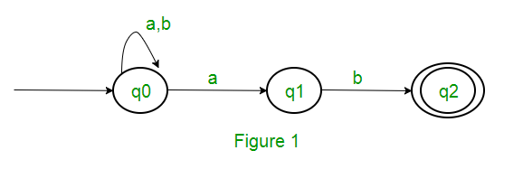
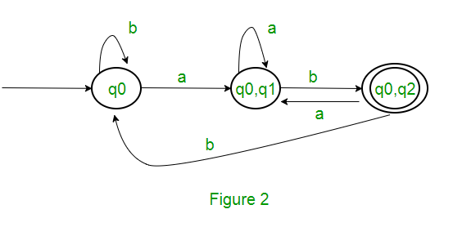
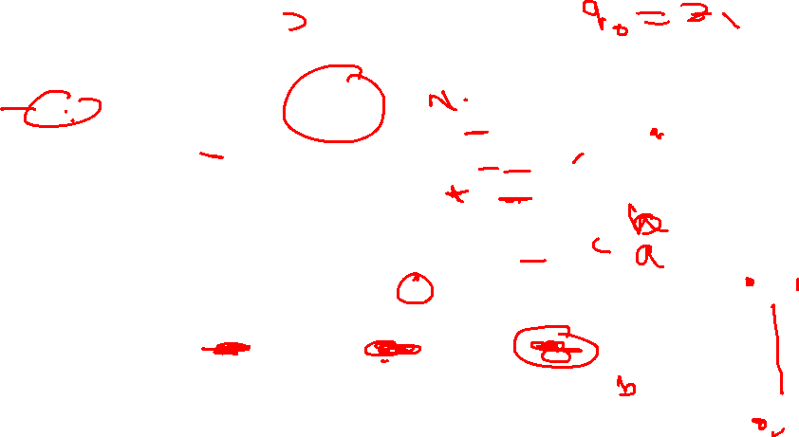
Convert NFA to DFA
State | a | b
q0 | {q0, q1} | q0
{q0, q1} | {q0, q1} | {q0, q2}
{q0, q2} | {q0, q1} | q0
NFA
DFA

Slide 25
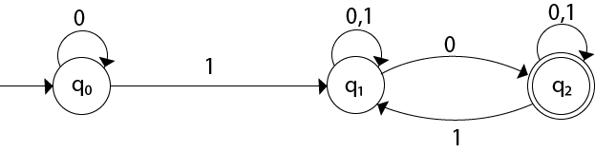
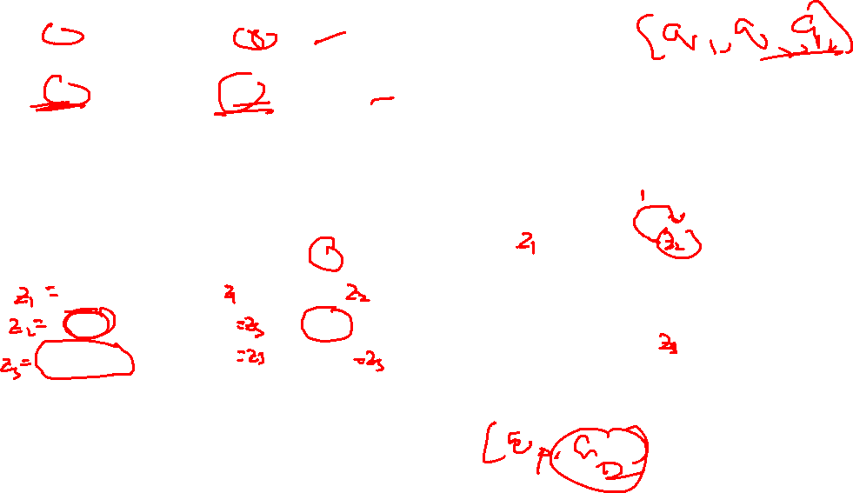
Convert NFA to DFA
NFA
0
1
q0
1
q1
State | 0 | 1
-[q0] | [q0] | [q1]
[q1] | [q1, q2] | [q1]
+[q1, q2] | [q1, q2] | [q1, q2]
0, 1
0
DFA
q1, q2

Slide 26
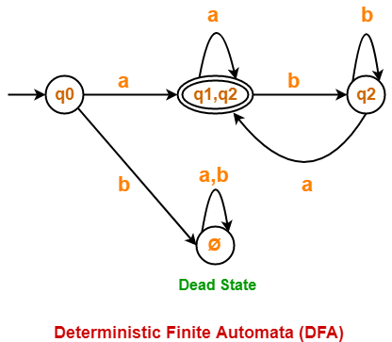
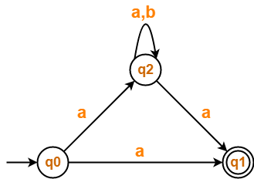
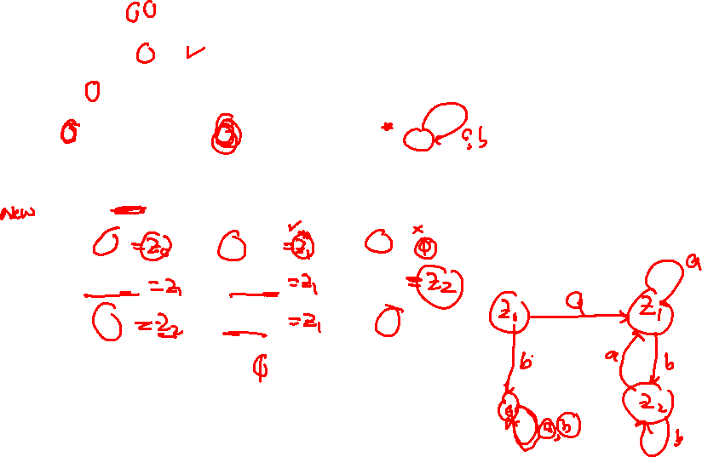
Convert NFA to DFA
NFA
DFA
State / Alphabet | a | b
- q0 | {q1, q2} | Ø
+{q1, q2} | {q1, q2} | q2
q2 | {q1, q2} | q2
Ø | Ø | Ø

Slide 27

Practice:
Convert the Following NFA to DFA
b
a,b
a
2
a
-
+
b

Slide 28
Practice:
Convert the Following NFA to DFA

Slide 29
Thanks

